Slide 1
Basic of Deep learning
Bijay Gaudel

Slide 2
Qualification for certificate
All 3 days attendance
Full time participation
Assignment completion

Slide 3
AI/ML/DL
Artificial Intelligence
AI
System that thinks rationally
System That acts rationally
ML
Machine Learning
DL
Learns from data rather than explicitly programmed
Deep Learning
Inspired from structure and function of brain

Slide 4
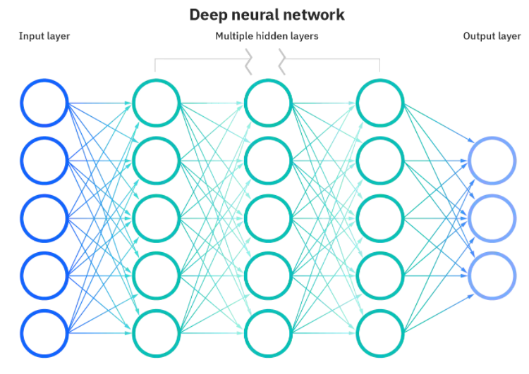
Basic of NN
Neuron
Input Layer
Hidden Layer
Output Layer
Training
Validation
Testing
Activation Function
Cost function
Learning Rate
Optimization
Local Minima
Global Minima
Evaluation Metrices
Fig: Deep Neural Network
Source: https://www.ibm.com/cloud/learn/neural-networks

Slide 5
How do NN works?
Model
Cost Function
Optimization

Slide 6
Model
Output of the machine learning algorithms run on a data
Algorithms results in a model comprised of vector or coefficient of weights and bias with specific values
Data + Prediction Algorithm = Model

Slide 7
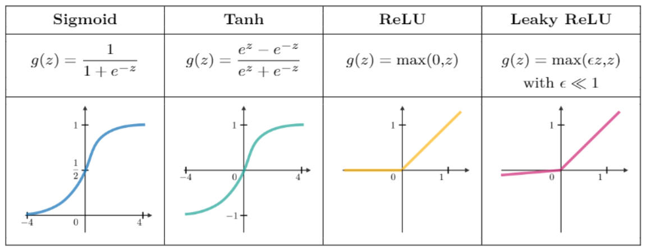
Activation function

Slide 8
Cost/Loss function
Measure of error between what actually is and what our model predicts
Entire model => Cost function
Single Epoch => Loss function
Types
Regression Loss Function
Binary Classification Loss Function
Multi-class Classification Loss Function

Slide 9
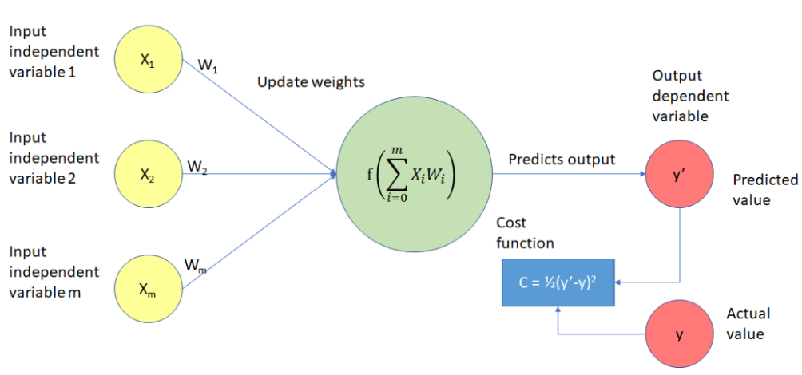
Cost/Loss function

Slide 10
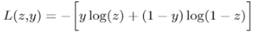
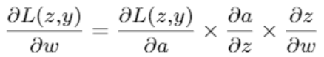
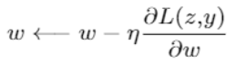

Optimization Process
Cross entropy loss :
Learning rate:
Indicate at which pace the weight get updated. Can be fixed or adaptively changed. Generally denoted by 𝜂.
Back propagation:
$$A=πr^{2}L$$
Method to update the weight in the neural network.
Weight update:

Slide 11
Optimization Process
Weight update:
Take a batch of training data
Perform forward propagation to obtain the corresponding loss
Backpropagate the loss to get the gradients
Use the gradient to update the weight of the network
$$A=πr^{2}L$$

Slide 12
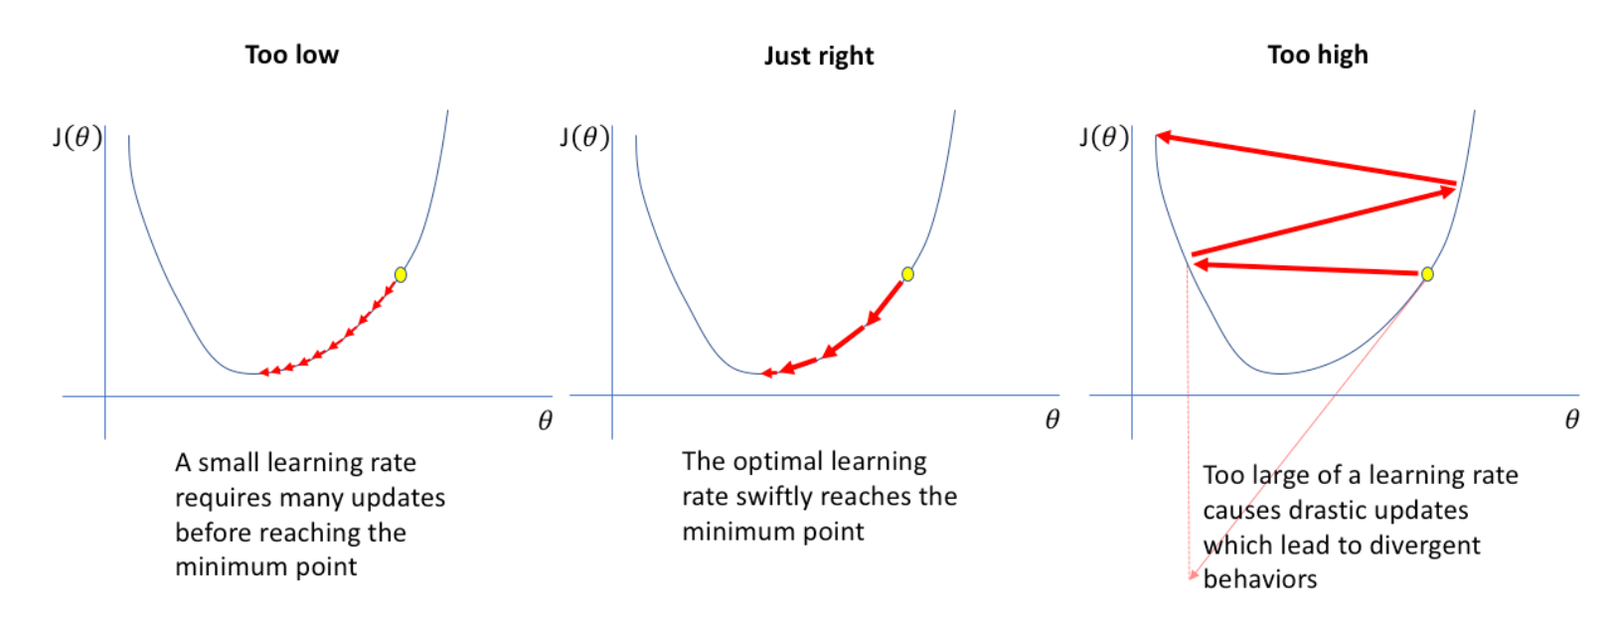
Learning rate
Hyper parameter
Generally, between 0 to 1
It defines how quickly the model converges to global minima

Slide 13
Vanishing vs exploding gradient
Vanishing Gradient: Derivative of loss function is small
Exploding Gradient: Derivative of loss function is large

Slide 14
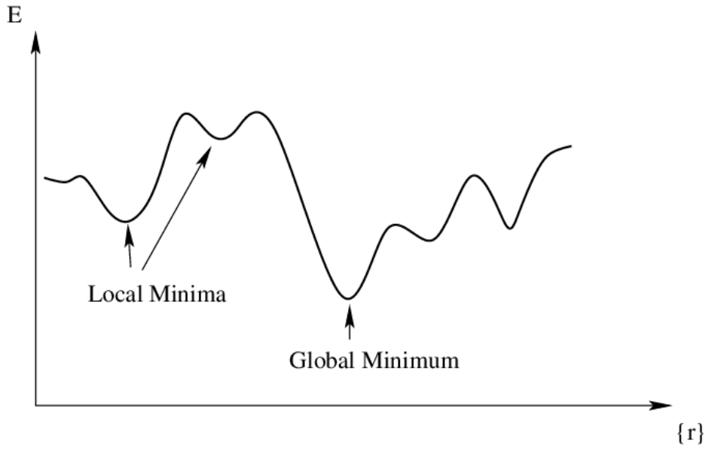
Global vs local Minima

Slide 15
How good is your model?
Bias:
Variance:
Difference between average prediction of model and correct value we are trying to predict
Ability of model prediction for a given data points or a value which tells us spread of data
$$A=πr^{2}L$$
Bias-Variance Tradeoff:
Model with low bias and low variance avoids both underfitting and overfitting

Slide 16
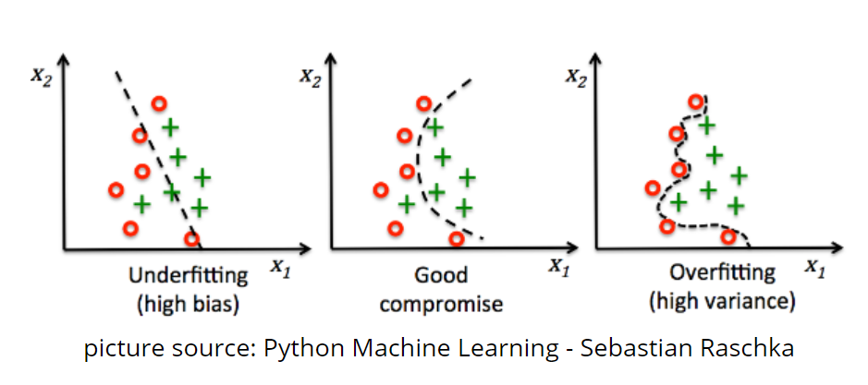
Bias-variance tradeoff
$$A=πr^{2}L$$

Slide 17
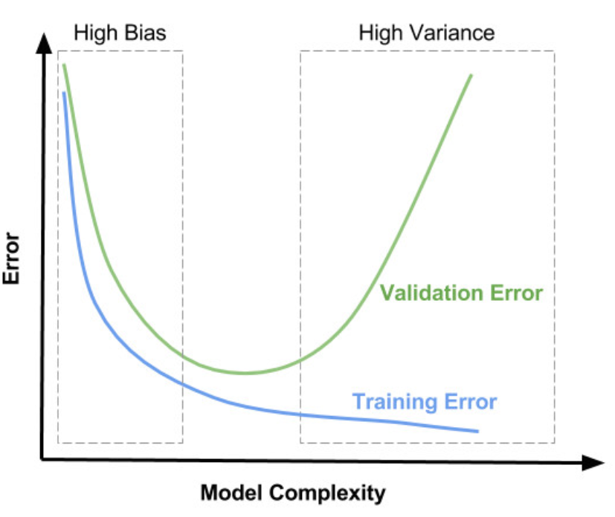
Bias-variance tradeoff
$$A=πr^{2}L$$

Slide 18
Regularization
Technique used for tuning the function by adding an additional penalty term in the error function.
The additional term controls the excessively fluctuating function.
Types:
$$A=πr^{2}L$$
L1-regularization
L2-regularization
Dropout

Slide 19
L1-Regularization
Let's consider simple model:
Y = wx+b
Loss (L) = Error(Y, Y_hat) = (wx+b-y_hat)**2
Loss with L1 regularization:
L1 = (wx+b-y_hat)**2 + ለ(|w|)
$$A=πr^{2}L$$

Slide 20
L2-Regularization
Let's consider simple model:
Y = wx+b
Loss (L) = Error(Y, Y_hat) = (wx+b y_hat)**2
Loss with L2 regularization:
L2 = (wx+b-y_hat)**2 + ለ(w**2)
$$A=πr^{2}L$$

Slide 21
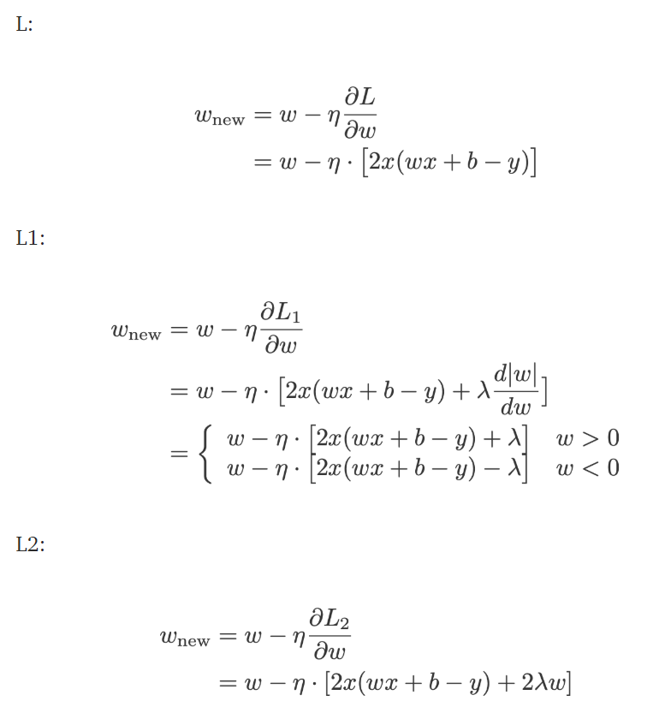
How overfitting prevented Using Regularization?
$$A=πr^{2}L$$

Slide 22
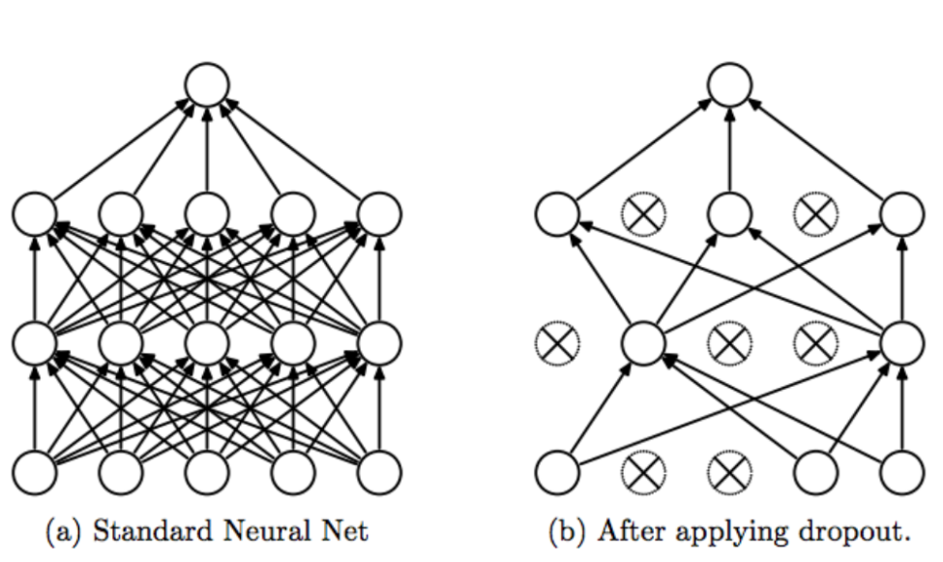
Dropout
Dropout technique works by randomly reducing the number of interconnected neurons within a neural network.
$$A=πr^{2}L$$

Slide 23
Frameworks
Bijay Gaudel

Slide 24


Slide 25
TensorFlow
Google open-source high level library for numerical computation (Mostly used in Machine learning and deep learning).
Developed by Google Brain team
First release : November 9, 2015
$$A=πr^{2}L$$

Slide 26

TensorFlow
$$A=πr^{2}L$$

Slide 27
TensorFlow
Training
Train datasets
Validation datasets
Epochs, batch size, etc
Compile
Loss function
Optimizer
Evaluation metrics
$$A=πr^{2}L$$
Evaluation
Test datasets
Prediction:
New data

Slide 28
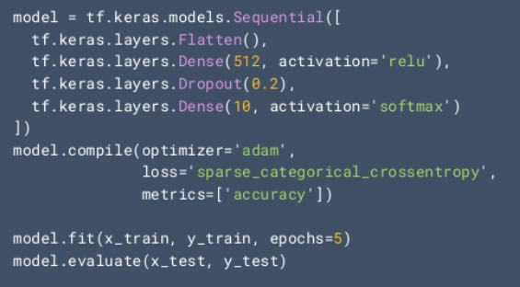
TensorFlow
For Beginners
$$A=πr^{2}L$$

Slide 29
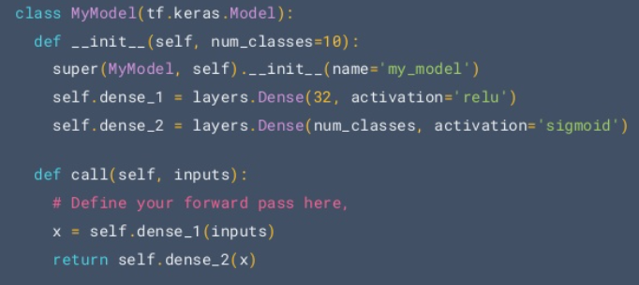
TensorFlow
For Expert
$$A=πr^{2}L$$

Slide 30
Computer vision
Bijay Gaudel

Slide 31
Computer Vision
Science and Technology of machine that see
Artificial system that obtain information from images
Image source: Video, Multi camera view, Multi dimensional data from sensors.
$$A=πr^{2}L$$

Slide 32
Computer Vision
Image acquisition
Pre-processing
Feature extraction
Detection/segmentation
Recognition
$$A=πr^{2}L$$

Slide 33
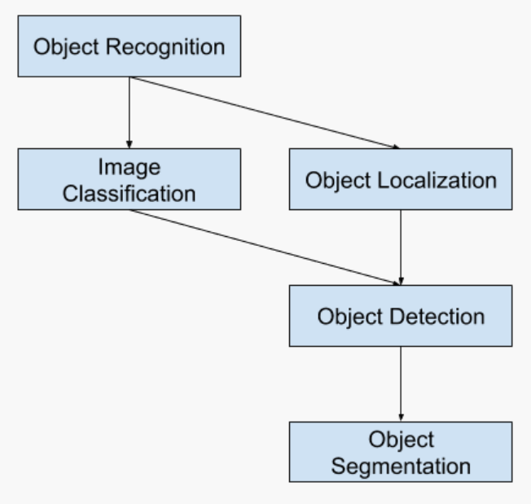
Object recognition
$$A=πr^{2}L$$
Fig: Overview of object recognition task

Slide 34
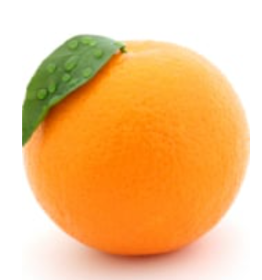

Image recognition clue
Color:
Does color play a role in recognition?
$$A=πr^{2}L$$

Slide 35
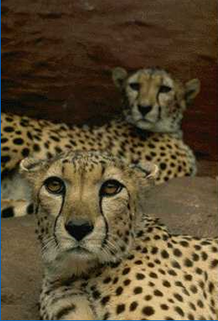
Image recognition clue
Texture:
Characteristic image texture can help us readily recognize objects.
$$A=πr^{2}L$$

Slide 36
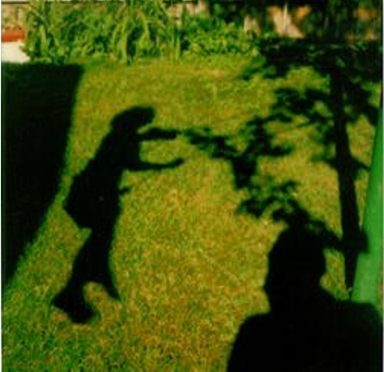
Image recognition clue
Shape:
$$A=πr^{2}L$$

Slide 37
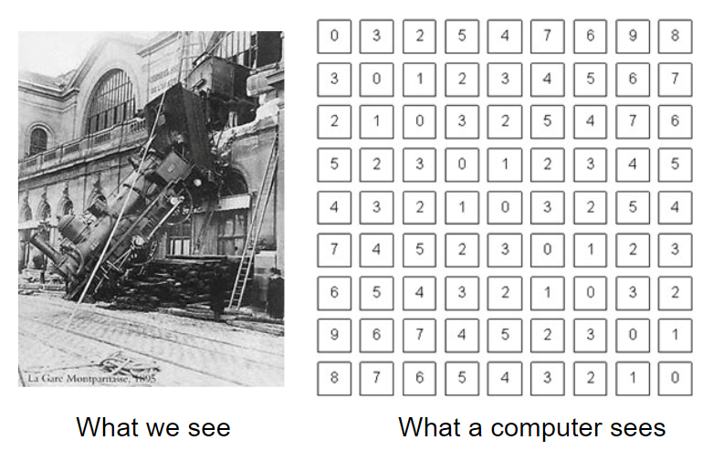
Human vision Vs computer vision
$$A=πr^{2}L$$

Slide 38
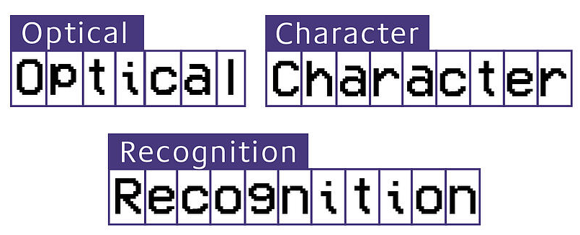
Applications
Optical Character Recognition
$$A=πr^{2}L$$

Slide 39

Applications
Face Recognition
$$A=πr^{2}L$$

Slide 40
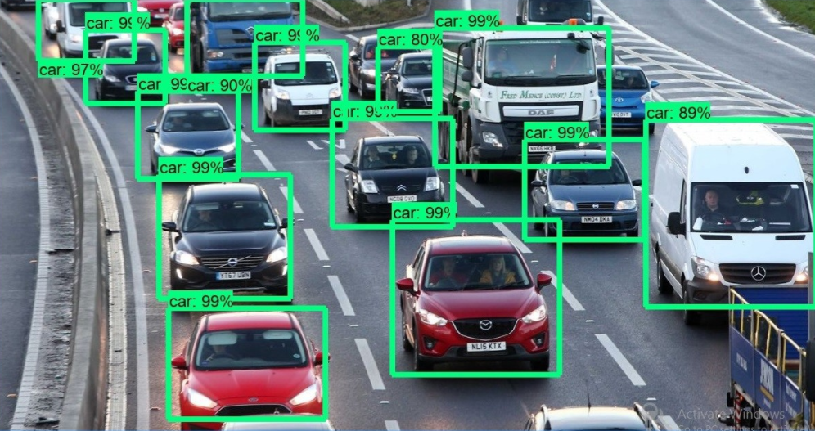
Applications
Traffic monitoring
$$A=πr^{2}L$$

Slide 41
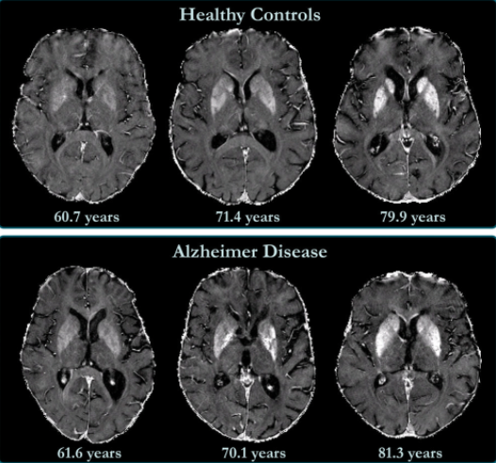
Applications
Medical imaging
$$A=πr^{2}L$$

Slide 42
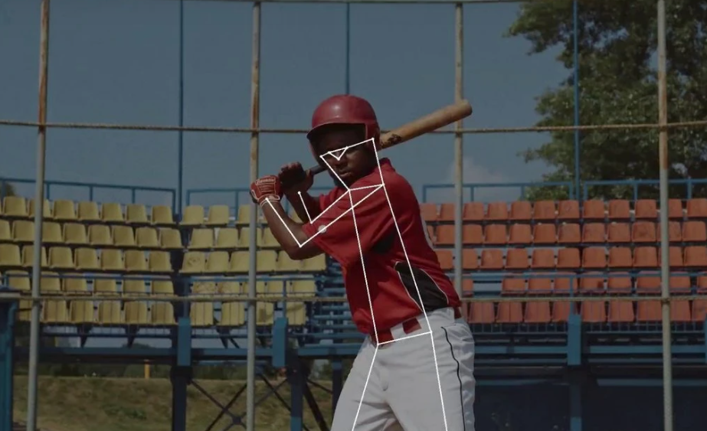
Applications
Real time coaching

Slide 43
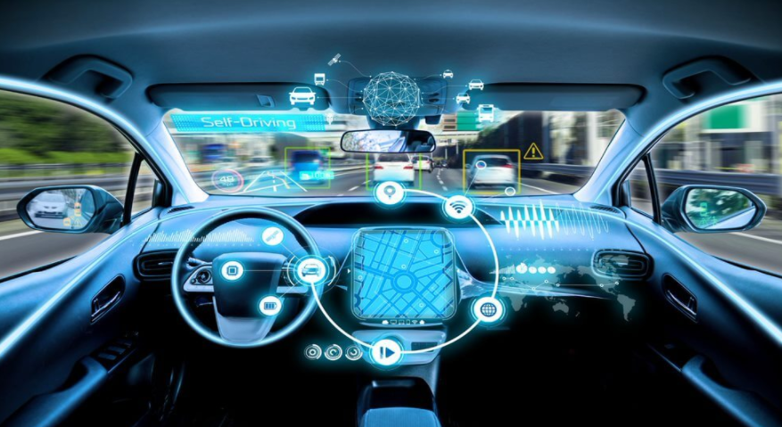
Applications
Self driving cars

Slide 44
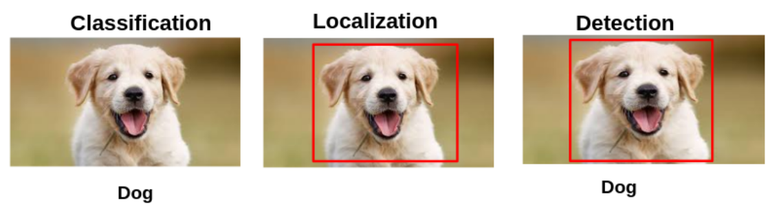
Classification Localization and Detection

Slide 45
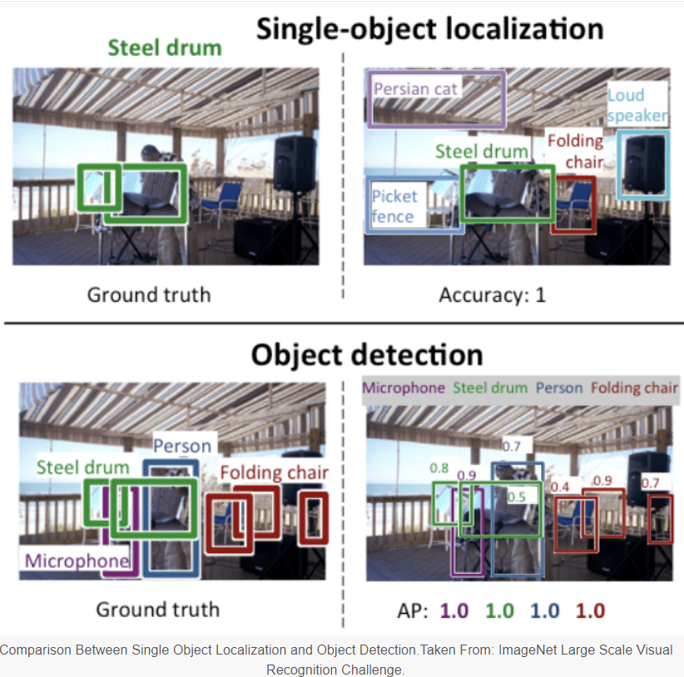
Localization and Detection
Source: https://machinelearningmastery.com/object-recognition-with-deep-learning/

Slide 46
Motivation
Recognize and Locate all known objects
Recovering pose of object in 3D
Obstacle avoidance
Path Planning

Slide 47
Techniques
You Only Look Once (YOLO)
Faster R-CNN
R-FCN
Single Shot Detector (SSD)
Spatial Pyramid Pooling (SPP-net)

Slide 48
You Only Look Once (YOLO)
Main focus is what and where
Clever Convolutional Neural Network (CNN)
Single Neural Network to the full Images
Divided the images and predict bounding boxes and probabilities for each region

Slide 49
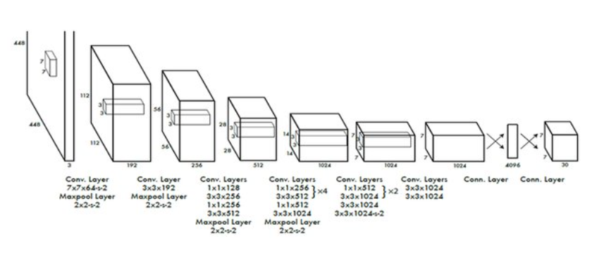
You Only Look Once (YOLO)

Slide 50
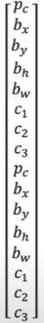
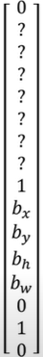
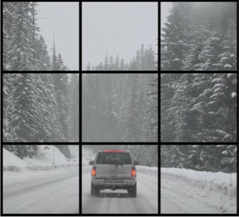
You Only Look Once (YOLO): Training
Class:
1 - Pedestrian
2 - Car
3 - Motorcycle
Y is 3*3*2*8

Slide 51
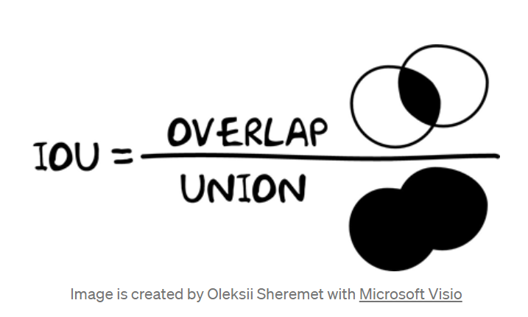
You Only Look Once (YOLO): IOU
Y is 3*3*2*8

Slide 52
You Only Look Once (YOLO): Non max suppressed outputs
For each grid cell get 2 predicted bounding boxes
Get rid of low probability prediction
For each class use non max suppression to generate final prediction

Slide 53
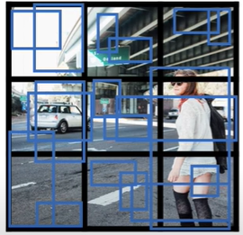
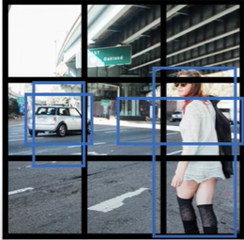
You Only Look Once (YOLO): Non max suppressed outputs

Slide 54
You Only Look Once (YOLO): Non max suppressed outputs
Step 1: Select the box with highest objectiveness score
Step 2: Then, compare the overlap (intersection over union) of this box with other boxes
Step 3: Remove the bounding boxes with overlap (intersection over union) <50%
Step 4: Then, move to the next highest objectiveness score
Step 5: Finally, repeat steps 2-4

Slide 55
Thank You

